Slide 1


MILESTONE 4 — WEEK 7–8 | INTERNSHIP PROJECT
SUPPORTLYTICS
IT SUPPORT ANALYTICS & PERFORMANCE INTELLIGENCE
Enterprise Business Intelligence Dashboard built with Microsoft Power BI for Monitoring Ticket Workload, Resolution Speeds, SLA Compliance & Similarity Patterns
MODULE 7 DELIVERABLE
MODULE 8 DELIVERABLE
Dashboard / Report Preparation
Documentation & Presentation
Microsoft Power BI
•
10,000 Tickets
•
38 Attributes
Presented By : Ayush Gupta
SUPPORTLYTICS | IT Support Analytics & Performance Intelligence
Slide 01 / 10

Slide 2



Project Objective & Business Need
STRATEGIC OBJECTIVES & ANALYTICAL WORKFLOW
Supportlytics provides interactive business intelligence to evaluate IT support ticket operations, identify resolution bottlenecks, track SLA compliance risk, and deliver actionable insights.
1. Ticket Workload & Categories
2. Performance & SLA Tracking
•
Categorize support demand across Incident, Request, and Problem ticket types.
•
Measure resolution speed across priority levels (Critical to Low).
•
Identify high-volume issue categories (Security, Hardware, Software).
•
Audit SLA compliance rates (Met vs Breached) across operational teams.
•
Analyze queue distribution across Finance, IT, and HR departments.
•
Monitor unresolved ticket backlog to prevent operational escalations.
3. NLP Clusters & Similarity
4. Geographic Benchmarking
•
Group related support tickets using NLP text clustering.
•
Benchmark support team speeds across global units.
•
Evaluate cluster similarity scores against customer satisfaction.
•
Analyze ticket concentration across North America, EMEA, and APAC.
•
Uncover recurring root-cause patterns (Network, Software, Login).
•
Enable interactive multi-dimensional slicing in Power BI.
Support Tickets
Data Analysis
Power BI Dashboard
Operational Insights
Recommendations
SUPPORTLYTICS | Project Objective & Business Need
Slide 02 / 10

Slide 3





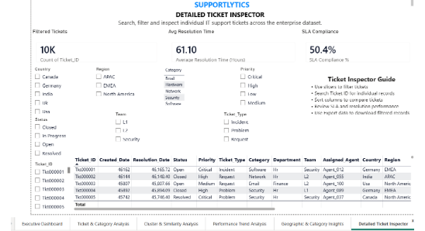

Dataset & Analytical Foundation
VERIFIED DATASET PROFILE & DATA PIPELINE ARCHITECTURE
DATASET SIZE
ATTRIBUTES
UNIQUE KEYS
AVG RESOLUTION
SLA RATE
AVG CSAT
10,000
38
10,000
61.10 hrs
50.39%
2.98 / 5
Support Tickets
Columns Analyzed
Ticket_IDs
Across Priorities
Compliance Score
Satisfaction Rating
Verified Source & Schema Profile
•
Source File: Supportlytics_PowerBI_Data.xlsx (Sheet: Data).
•
Ticket Info: Ticket ID, Created Date, Resolution Date, Ticket Type, Status.
•
Operations: Priority, Category, Department Queue, Assigned Team & Agent.
•
Geography: Country (US, UK, IN, DE, CA), Region (NA, EMEA, APAC).
•
Analytics: Resolution Duration, CSAT Score, SLA Status, Similarity Index.
Power BI Data Modeling
•
Calendar Table: Dedicated date dimension integrated for time-series analysis.
•
Geographic Mapping: Latitude/Longitude dimensions mapped for spatial visuals.
•
Unresolved Backlog: Dedicated DAX logic tracking open high-priority tickets.
SUPPORTLYTICS | Dataset & Analytical Foundation
Slide 03 / 10

Slide 4





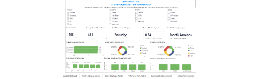
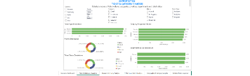
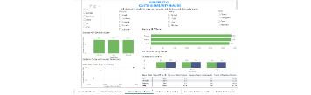





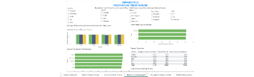
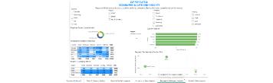
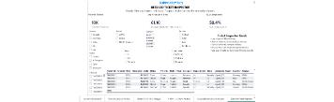
Power BI Dashboard Architecture
SIX-PAGE MODULAR BUSINESS INTELLIGENCE STRUCTURE
1. Executive Overview
2. Ticket & Category Analysis
3. Cluster & Similarity Analysis
Enterprise-level KPI summary and core support operations.
Workload and category patterns across enterprise departments.
Issue similarity, NLP cluster behavior, and SLA risk patterns.
4. Performance Analysis
5. Geographic Analysis
6. Ticket Details
Resolution speeds and operational SLA performance benchmarking.
Regional and country-level insights and workload concentration.
Detailed ticket investigation with robust filtering capabilities.
SUPPORTLYTICS | Power BI Dashboard Architecture
Slide 04 / 10

Slide 5


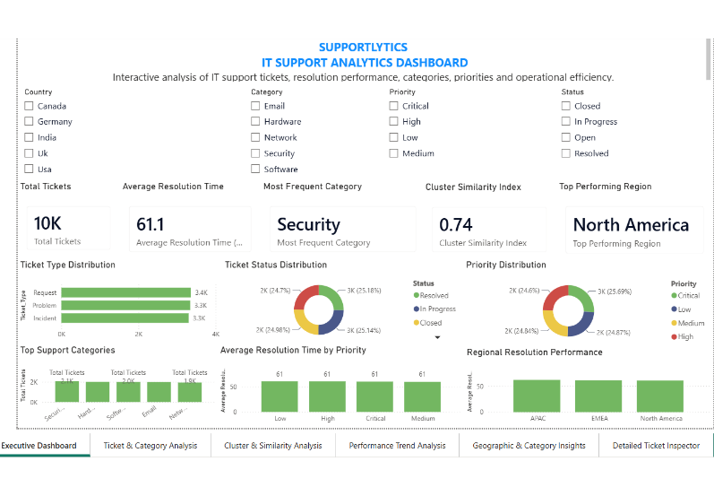




Power BI — Executive Overview
PAGE 1 CONSOLIDATED COMMAND CENTER & REQUIRED MODULE 7 KPIS
MODULE 7 REQUIRED KPI 1
Avg Resolution Time
61.1032 Hours
Overall resolution speed across priorities.
MODULE 7 REQUIRED KPI 2
Most Frequent Category
Security (2,068)
Top support issue category volume driver.
MODULE 7 REQUIRED KPI 3
Cluster Similarity Index
0.7446 Score
Quantifies similarity across recurring issues.
MODULE 7 REQUIRED KPI 4
Top Performing Region
North America
Highest volume & balanced resolution speed.
Additional KPIs:
SUPPORTLYTICS | Power BI — Executive Overview
Slide 05 / 10

Slide 6


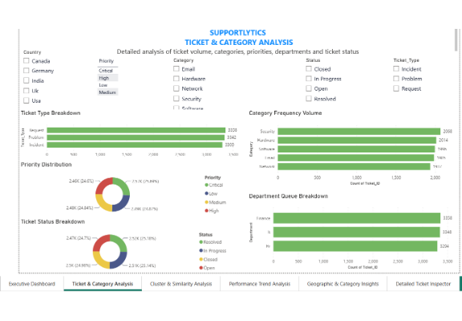
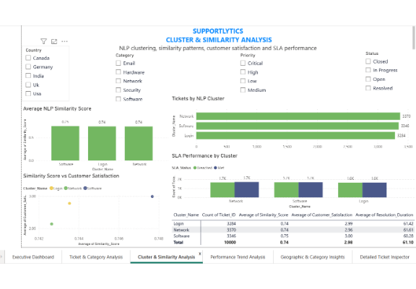


Ticket, Category & Cluster Intelligence
PAGES 2 & 3 — WORKLOAD DISTRIBUTION, CATEGORY FREQUENCY & NLP SIMILARITY ANALYSIS
Ticket & Category Analysis (Page 2)
Cluster & Similarity Analysis (Page 3)
Verified Workload Breakdown:
NLP Similarity Patterns:
•
Ticket Types: Request: 3,358 | Problem: 3,342 | Incident: 3,300
•
Actual Issue Clusters: Network (3,370), Software (3,346), Login (3,284).
•
Categories: Security: 2,068 | Hardware: 2,014 | Software: 1,996 | Email: 1,985 | Network: 1,937
•
Similarity Index: Overall Cluster Similarity Index is 0.7446.
•
Queue Focus: Finance (3,358) and IT (3,348) account for top queues.
•
SLA Risk: Software cluster exhibits high SLA breach ratios requiring root-cause intervention.
SUPPORTLYTICS | Ticket, Category & Cluster Intelligence
Slide 06 / 10

Slide 7


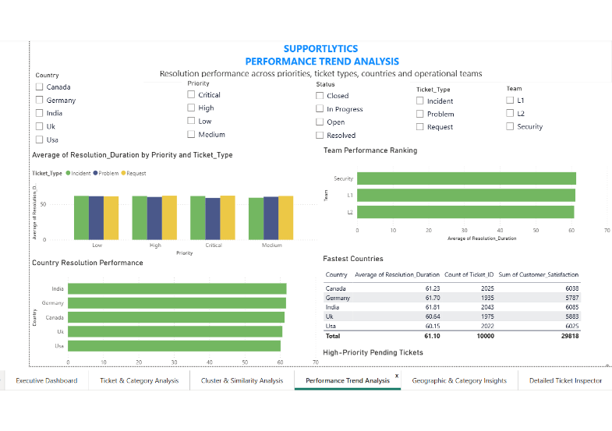




Performance & SLA Intelligence
PAGE 4 — RESOLUTION SPEEDS, SLA ADHERENCE & HIGH-PRIORITY UNRESOLVED BACKLOG
AVERAGE RESOLUTION TIME
61.1032 Hours
Uniform speed across priorities
SLA MET
SLA BREACHED
5,039
4,961
50.39% Compliance
49.61% Breach Rate
Unresolved Backlog Risk
2,504 Tickets
High / Critical Priority tickets in Open or In Progress state.
Support Team Speed Benchmarks:
•
L2 Team: 60.80 hrs avg resolution (3,358 tickets).
•
L1 Team: 61.18 hrs avg resolution (3,365 tickets).
•
Security Team: 61.34 hrs avg resolution (3,277 tickets).
SUPPORTLYTICS | Performance & SLA Intelligence
Slide 07 / 10

Slide 8
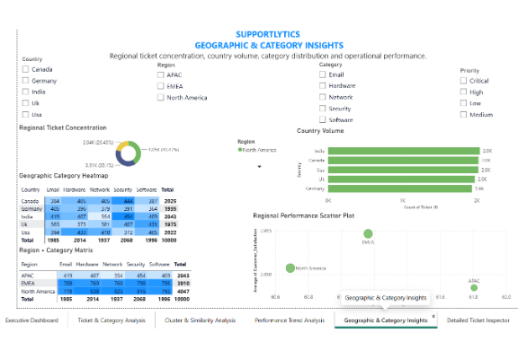
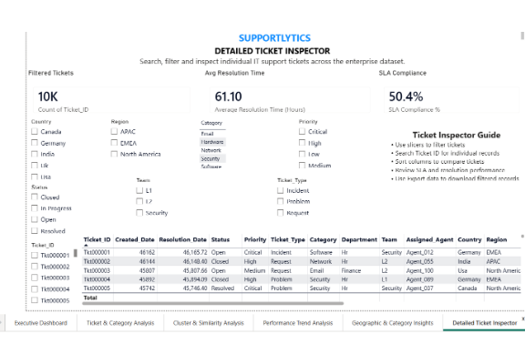
Geographic & Detailed Ticket Intelligence
PAGES 5 & 6 — REGIONAL CONCENTRATION, SPATIAL HEATMAPS & GRANULAR TICKET INSPECTION
Geographic Analysis (Page 5)
Ticket Details (Page 6)
Regional Concentration & Speeds:
Micro-Level Audit Inspector:
•
Regional Share: North America (40.47%), EMEA (39.10%), APAC (20.43%).
•
Multi-Slicer Filter Engine: Filter by Country, Priority, Status, Team, Category.
•
Fastest Countries: USA (60.15 hrs) and UK (60.64 hrs) record top speeds.
•
Individual Search: Search by Ticket_ID to inspect individual SLA & CSAT.
•
Category Heatmap: India leads Security issues (454); NA leads Hardware (838).
•
Operational Auditing: Review assigned agent performance and export records.
SUPPORTLYTICS | Geographic & Detailed Ticket Intelligence
Slide 08 / 10

Slide 9


Key Insights & Strategic Recommendations
DATA-DRIVEN FINDINGS & ACTIONABLE OPERATIONAL INTERVENTIONS
Verified Operational Insights
Strategic Recommendations
•
Enterprise Workload: Analyzed 10,000 tickets with an average resolution duration of 61.1032 hours.
•
Strengthen SLA Monitoring: Implement automated Power BI alerts and escalation protocols for tickets approaching SLA limits.
•
SLA Compliance Deficit: SLA compliance stands at 50.39% (5,039 Met vs 4,961 Breached), highlighting substantial service-level risk.
•
Prioritize Critical Backlog: Mobilize dedicated L2/Security task forces to clear the 2,504 High/Critical unresolved tickets.
•
Critical Backlog: 2,504 High and Critical priority tickets remain in an unresolved (Open / In Progress) state.
•
Root-Cause Clustering: Develop self-service knowledge base modules addressing recurring Login and Network cluster issues.
•
Category & Cluster Drivers: Security leads ticket volume (2,068 tickets). Recurring issue clusters are Network, Software, and Login.
•
Optimize Team Allocation: Rebalance ticket queues between L1, L2, and Security teams based on category demand.
•
Satisfaction Benchmark: Average CSAT score is 2.9818 / 5, correlating with high SLA breach rates in software queues.
•
Investigate Low CSAT: Conduct targeted audits on Software cluster tickets to improve customer satisfaction ratings.
•
NLP Similarity: Overall Cluster Similarity Index is 0.7446, indicating strong structural duplication across issues.
•
Regional Support Tuning: Leverage geographic insights to align staffing with peak volume hours in EMEA and North America.
SUPPORTLYTICS | Key Insights & Strategic Recommendations
Slide 09 / 10

Slide 10





Milestone 4 — Completion & Deliverables
SUMMARY OF MODULE 7 & MODULE 8 FINAL IMPLEMENTATION DELIVERABLES
Module 7: Dashboard / Report Preparation
Module 8: Documentation & Presentation
•
Power BI Dashboard Completed: Built Supportlytics.pbix with 6 interactive analytical report pages.
•
Project Documentation: Comprehensive technical documentation and README prepared.
•
Final PDF Report: Published complete project report detailing methodology and data findings.
•
Module 7 KPIs Implemented: Average Resolution Time, Most Frequent Category, Cluster Similarity Index, and Top Performing Region.
•
Presentation Deck: Created 10-slide executive presentation for project evaluation.
•
Interactive Slicers: Slicing by Country, Priority, Status, Category, Ticket Type, and Created Date.
•
GitHub Repository: Uploaded .pbix file, data notebooks, and documentation to GitHub.
•
NLP & Spatial Insights: Embedded NLP cluster similarity scoring and geographic heatmap matrix.
Power BI Dashboard
Project Documentation
Presentation Deck
6 Interactive Pages (.pbix)
Final PDF & Technical Report
10-Slide Milestone 4 PPTX / PDF
Thank You
SUPPORTLYTICS — IT Support Analytics
Transforms IT support ticket data into actionable performance intelligence through Microsoft Power BI.
SUPPORTLYTICS | Milestone 4 Completion & Deliverables
Slide 10 / 10

